Slide 1
Basic CNN

Slide 2
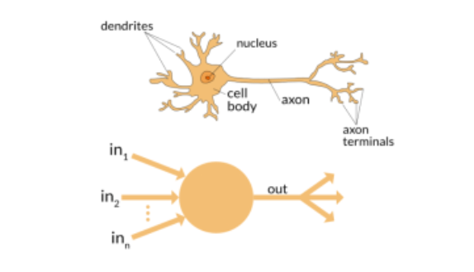
Human Brain
Notes:
What is ML?

Slide 3
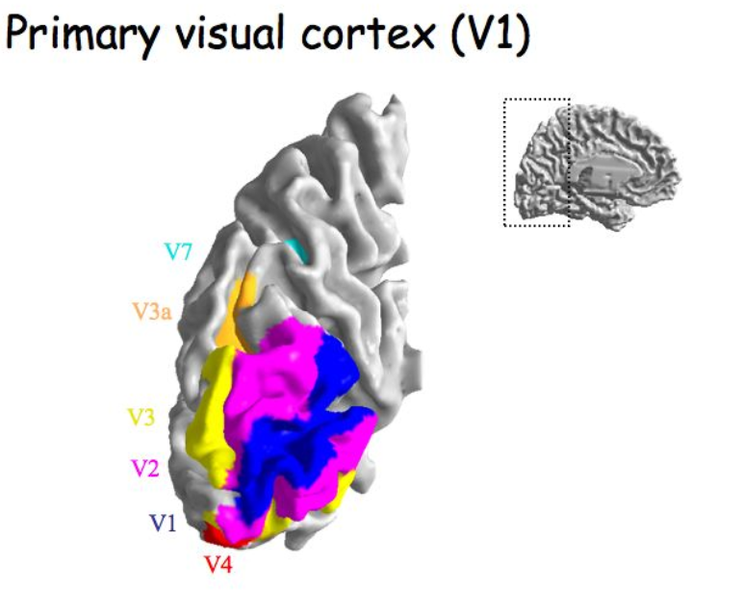
Human Brain Visual Part
Notes:
What is ML?

Slide 4
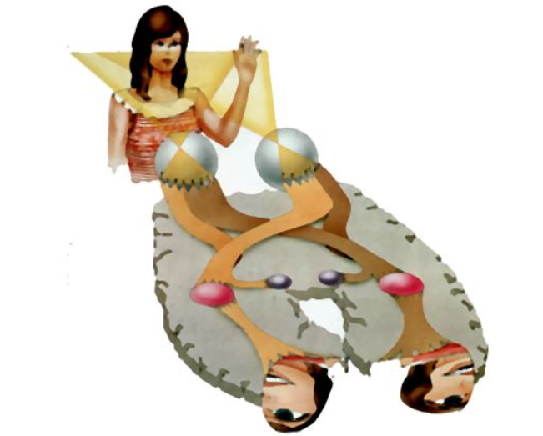
From retina to cortex
Notes:
What is ML?

Slide 5
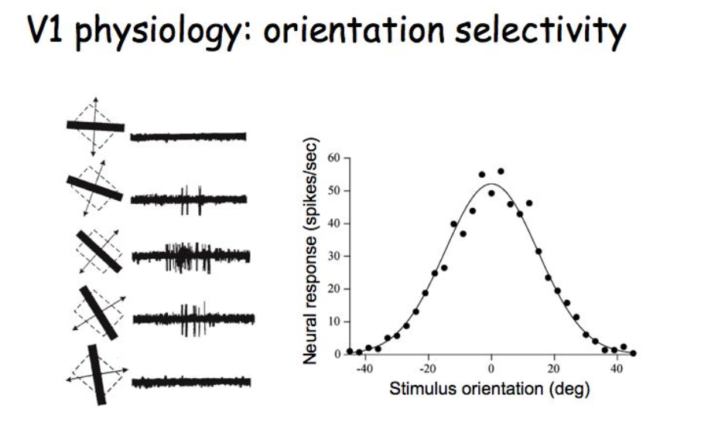

Slide 6

CNN
http://parse.ele.tue.nl/cluster/2/CNNArchitecture.jpg

Slide 7
CNN
Convolution
Non Linear(Relu for example)
Pooling or sub sampling( Max Pooling for example)
Classification (Full connected layer)

Slide 8
Convolutional Layers

Slide 9
Input Image, Kernel(Filter),
Feature Map(Output Volume)

Slide 10
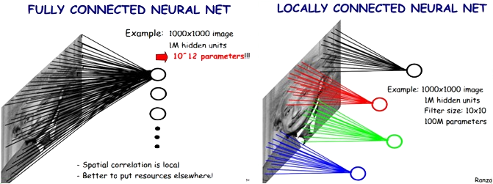
Locally Connected Features
https://ireneli.eu/2016/02/03/deep-learning-05-talk-about-convolutional-neural-network%EF%BC%88cnn%EF%BC%89/

Slide 11

An Image is a 2D matrix

Slide 12
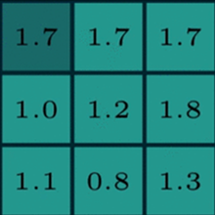
Two maxtrics interact
Reception field
A kernel(filter, neuron)
Numbers: weights

Slide 13
Two maxtrics interact
Sliding

Slide 14
Two maxtrics interact

Slide 15
Two maxtrics interact

Slide 16

Kernel(Filter)
255
200
0
*
=
155
55
35
???
55
10
5

Slide 17
Two maxtrics interact

Slide 18
Two maxtrics interact

Slide 19
Two maxtrics interact

Slide 20

Generate a new image
32 X 32 X 3
5x5x3
Feature Map
(Activation Map)
(Output Volume)
28 X 28 X 3

Slide 21

Generate a new image

Slide 22
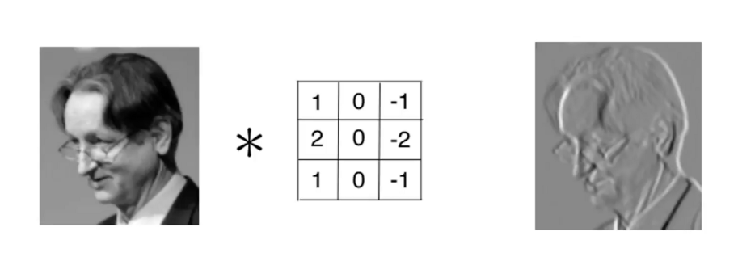
Kernel is used as Feature Detector

Slide 23
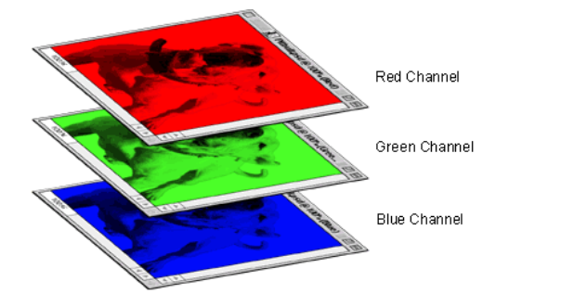
A colored image is 3 x 2d matrix

Slide 24
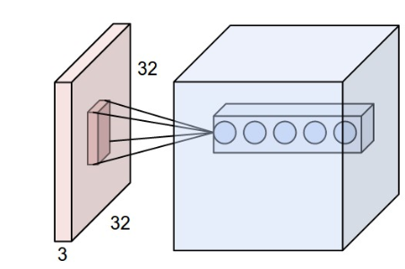
Convolve in 3D(32x32x3) Input Image
Every kernel should be (mxmx3) size
The kernel slide over the xy plane with same depth(3)
The product of 3D image and 3D kernel is still a 2D plane.
The output volume is the stack of all planes created by all kernels.
In this example the output volume is nxnx5 dimension.

Slide 25
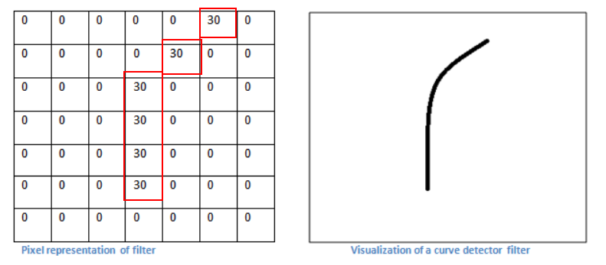
A filter is just a feature identifier

Slide 26
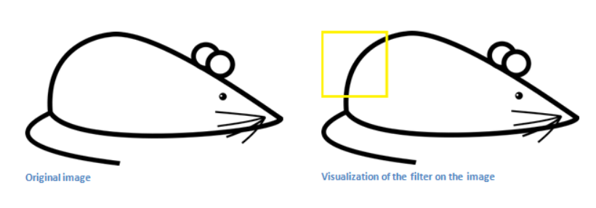
Filter on a part of an image

Slide 27
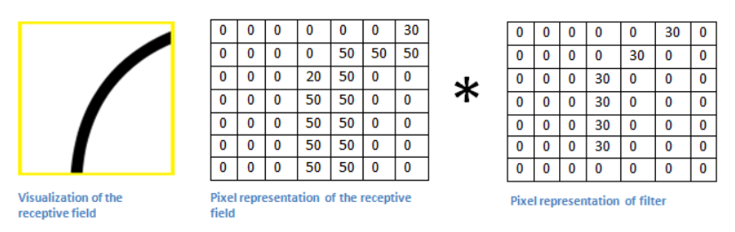
Just matrics multiplication

Slide 28
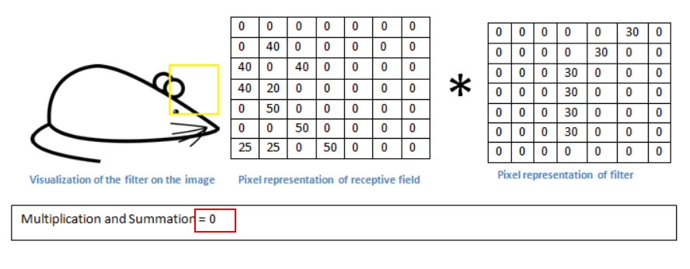
Without the feature

Slide 29
Filters = Feature Detectors
A filter for a unique feature.
Millions of filters in a convolutional network
Higher number ‘fires’ means the feature is detected
So many different feature detectors for different features.

Slide 30
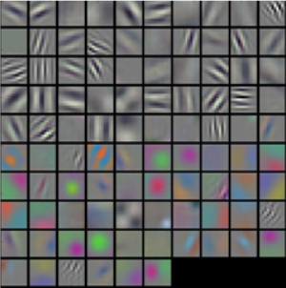
Filters = Feature Detectors

Slide 31
Layers that extract features
Earlier layers extract low level object like curves and edges.
We need the network to recognize higher level features such as hands, or paws or ears.
Different neurons in each layer is representing a feature to detect different objects, like faces, texts.

Slide 32
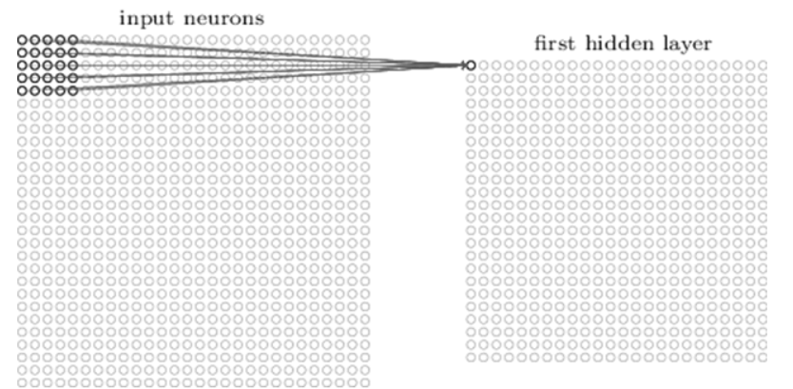
A first layer neuron:
The number of weight is 5x5x1(Kernel dimension ) + 1 bias.

Slide 33
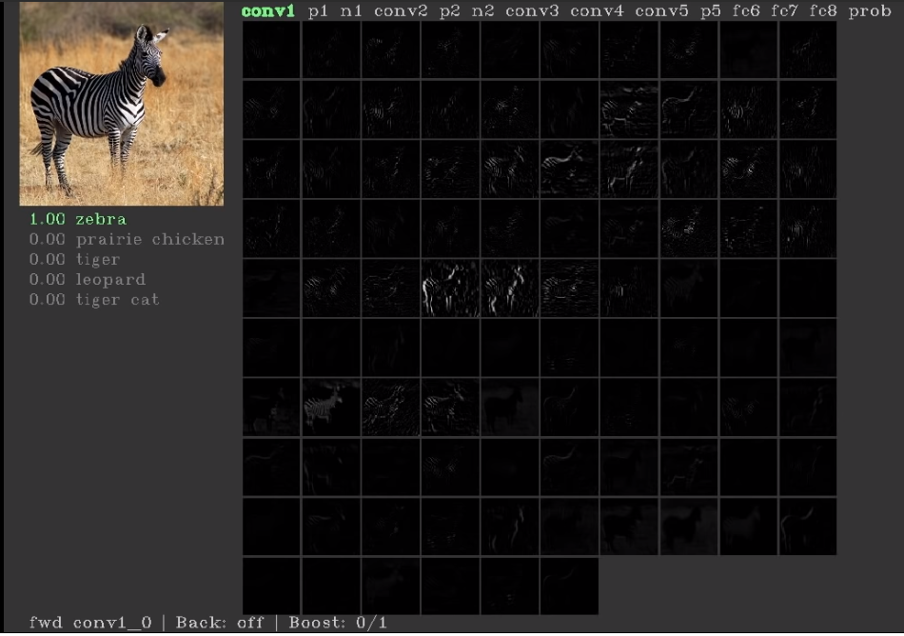
First layers’ neurons for basic features(conv1)

Slide 34
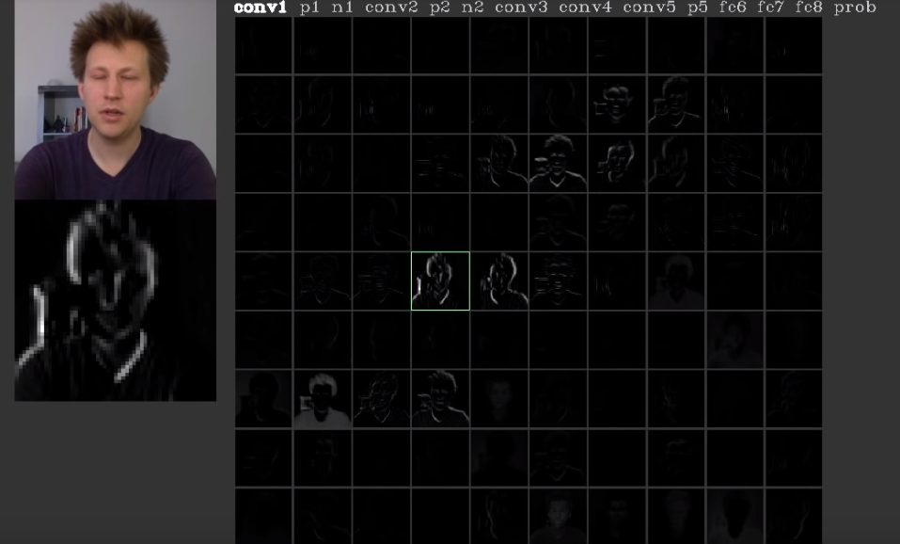
First layers’ neurons for basic features(conv1)

Slide 35
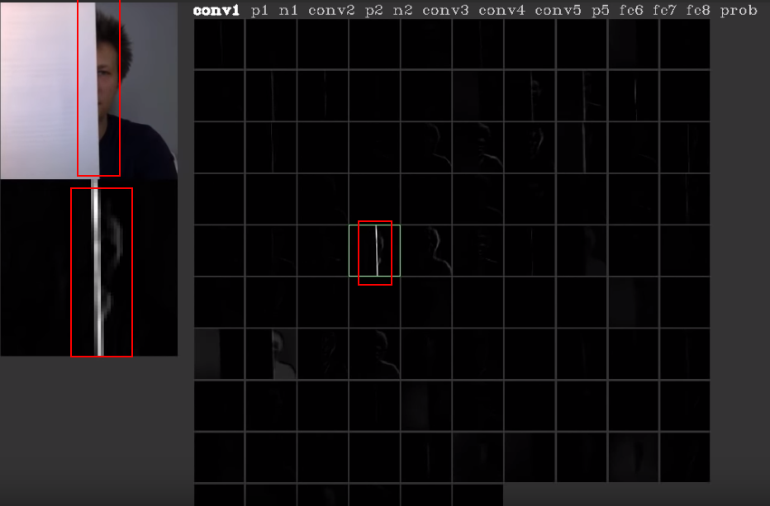
The neuron is for edges

Slide 36
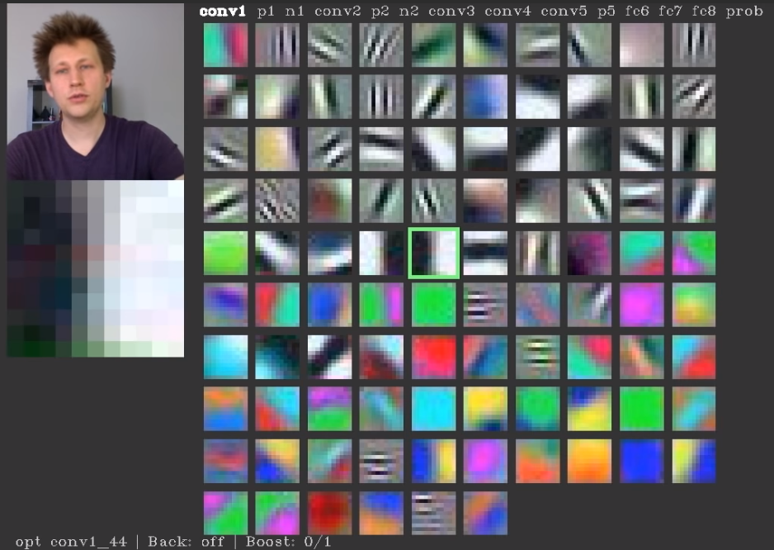
Every neuron is looking for something

Slide 37
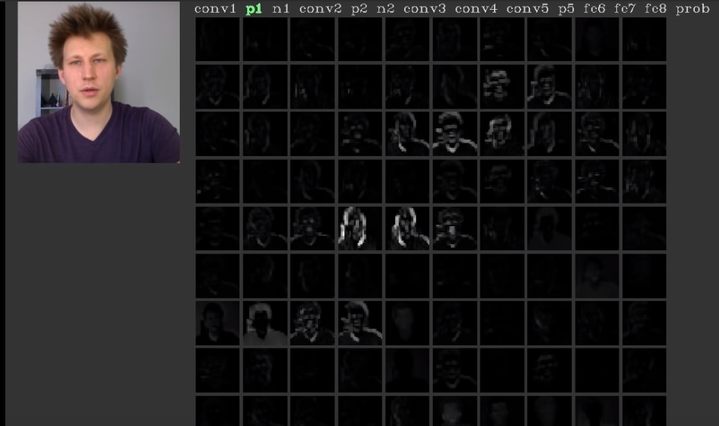
Pooling layer

Slide 38
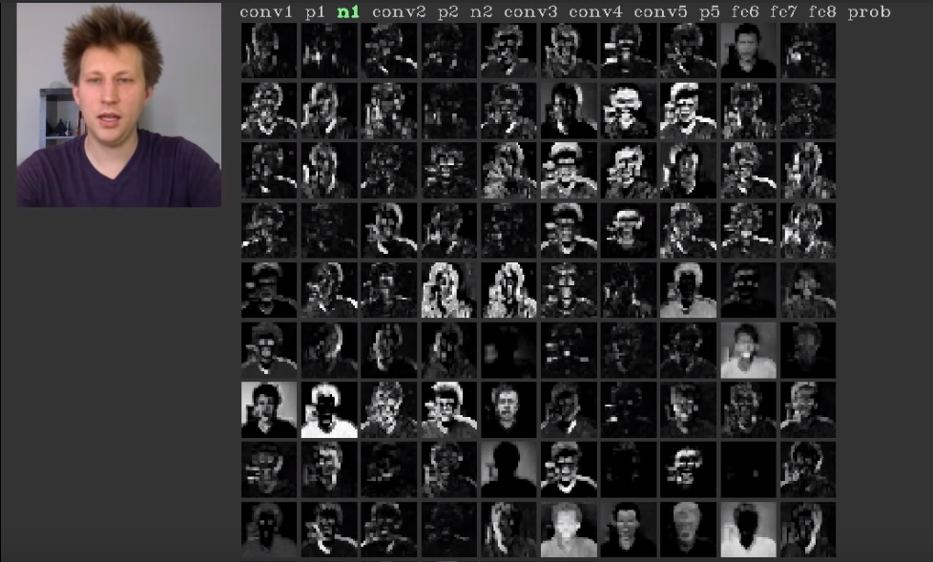
Normalise layer

Slide 39
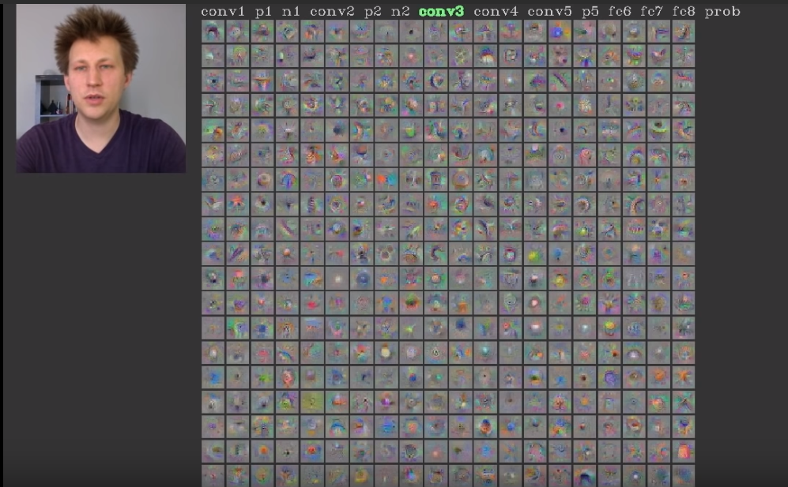
Con3 layer

Slide 40
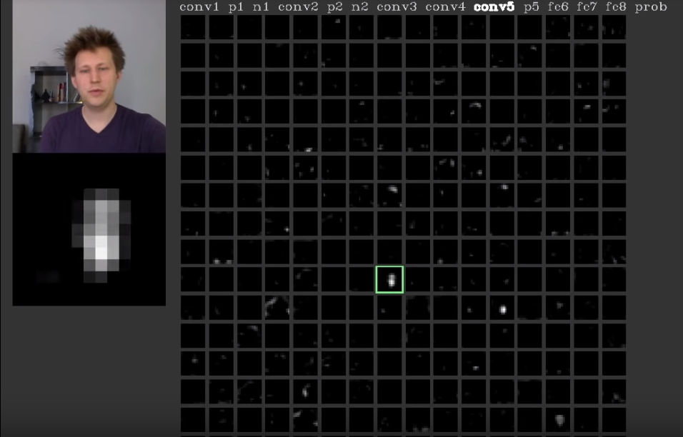
Neuron in con5 layer is for faces

Slide 41
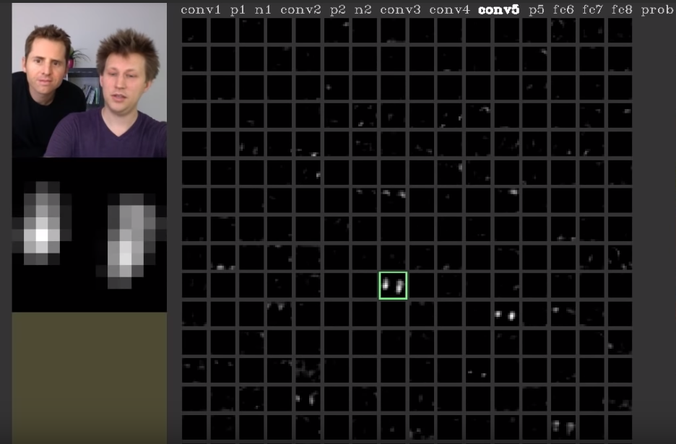
Neuron in con5 layer is for faces

Slide 42
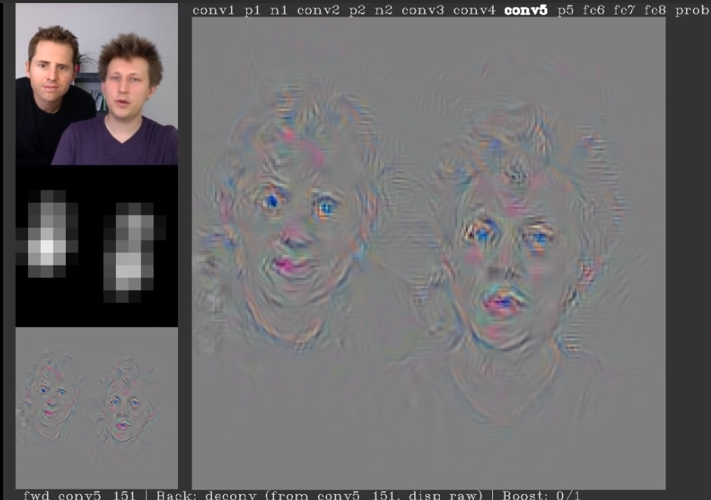
Neuron in con5 layer is for faces

Slide 43
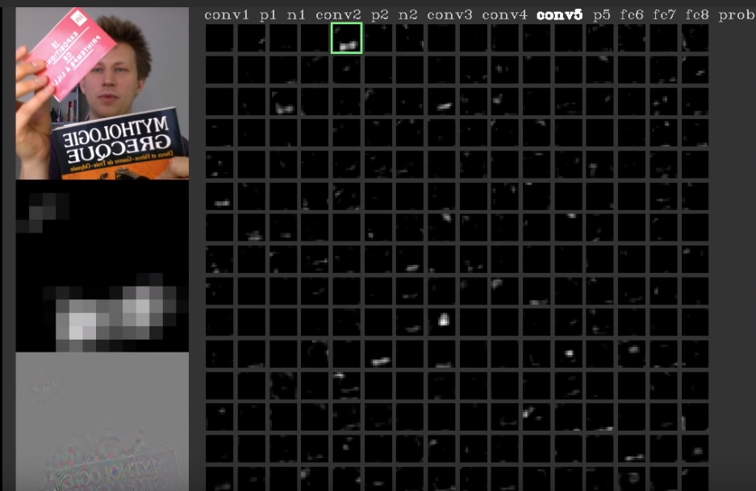
Neuron in con5 layer is for printed texts

Slide 44
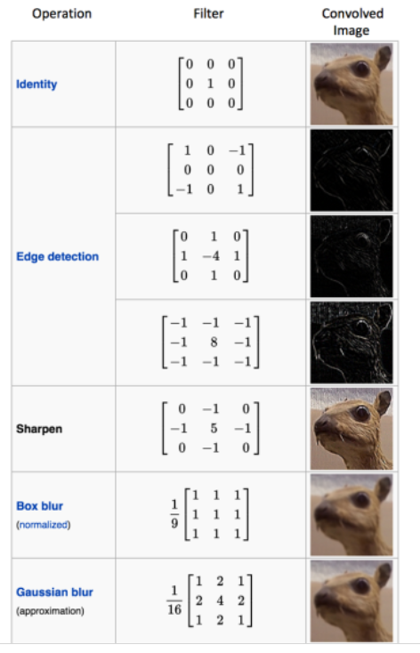
Different filters can detect different features from an image

Slide 45
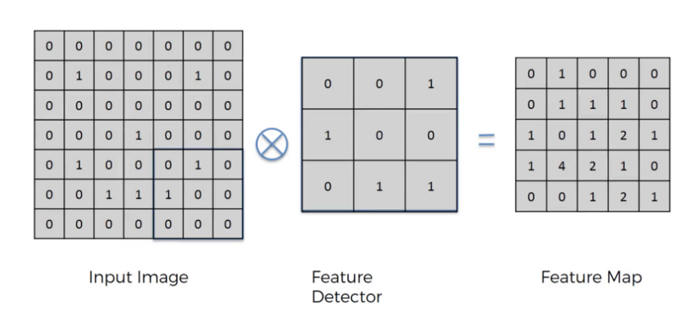
Convolution

Slide 46
Convolution
Convolution is a mathematical operation on two functions
To produce a third function that expresses how the shape of one is modified by the other.
The term convolution refers to both the result function and to the process of computing it. Convolution is similar to cross-correlation
Convolution preserves the spatial relationship between pixels by learning image features using small squares of input data.

Slide 47
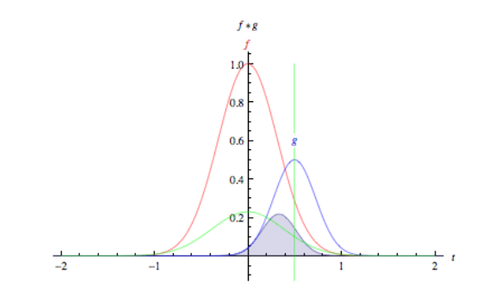
Convolution

Slide 48

Convolution

Slide 49

Two images convolve

Slide 50
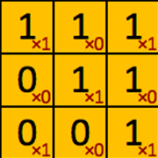
filter‘ or ‘kernel’ or ‘feature detector

Slide 51
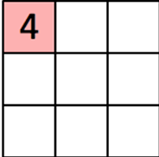
Convolved Feature’ or ‘Activation Map’ or the ‘Feature Map‘

Slide 52

Convolution operation captures the local dependencies in the original image

Slide 53
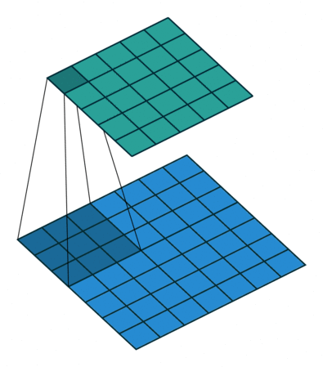
Convolution in Action
https://github.com/vdumoulin/conv_arithmetic

Slide 54
Relu Layers

Slide 55
Relu Layers
Added after every convolutional layer.
As non-linear layer(activation layer)
Since all conv layers are doing linear computing.
Used to use tanh and sigmoid.
Relu is faster.
f(x) = max(0, x)

Slide 56
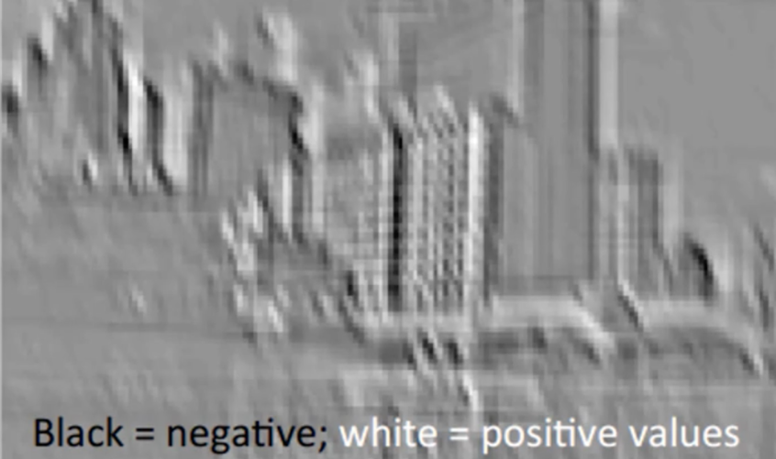
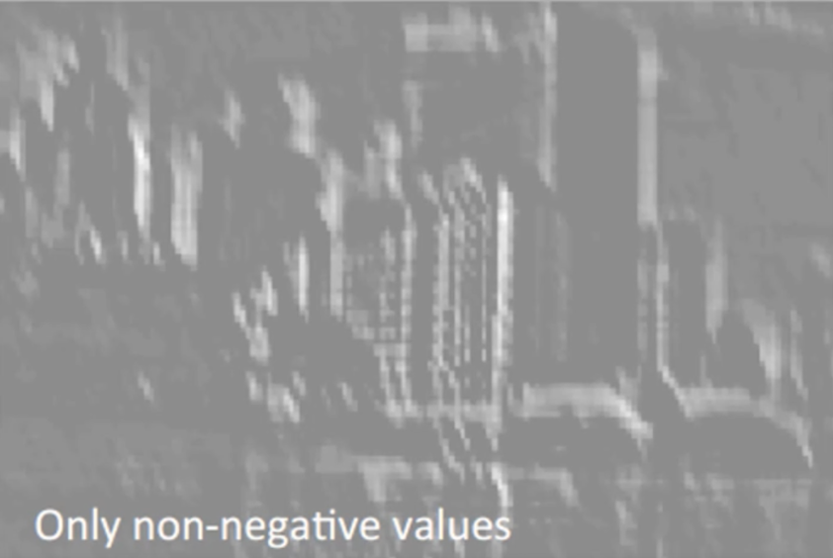
Relu, delete negative(black)

Slide 57
Size of featured map
Depth
Stride
Zero-padding
https://github.com/vdumoulin/conv_arithmetic

Slide 58
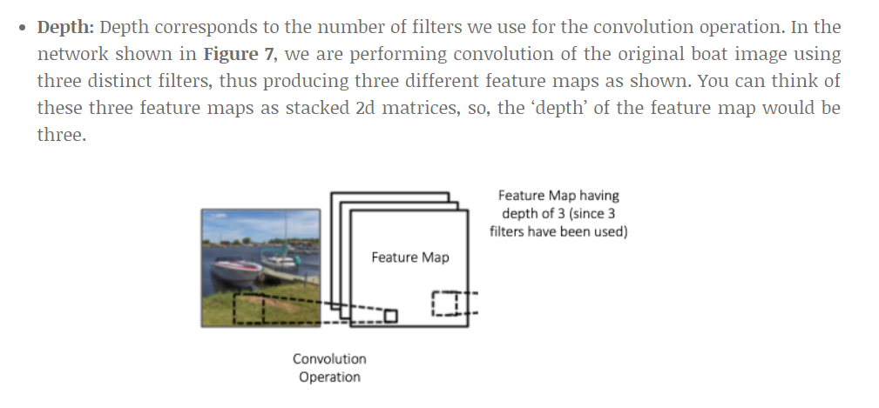
Depth(Number of filters)
https://github.com/vdumoulin/conv_arithmetic

Slide 59
Stride
How many cell we move the kernel.
Bigger stride, smaller output image.
Usually less than 3.

Slide 60
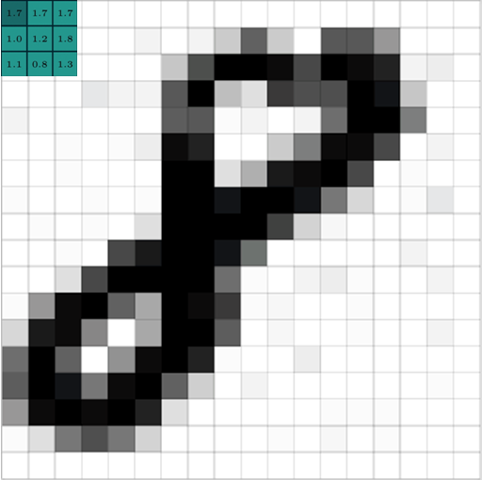
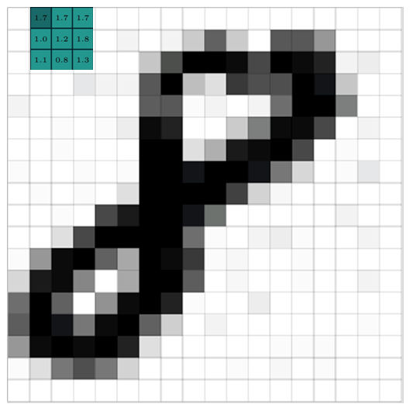
Stride = 1

Slide 61
Stride = 2

Slide 62
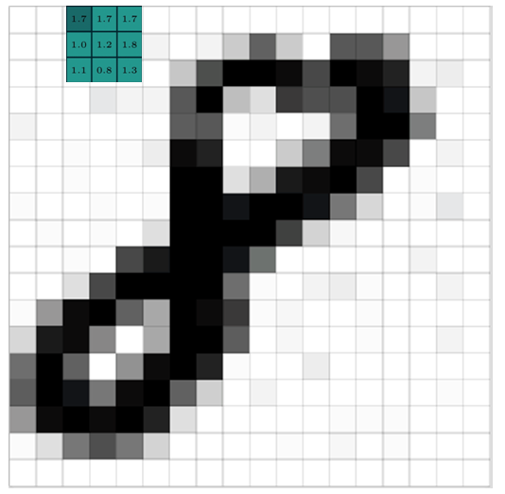
Stride = 1

Slide 63
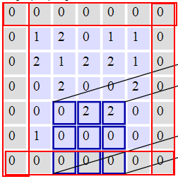
Zero Padding
Pad cells around a map
Could be any size
Usually 0-2
Purpose is to keep the output map the same dimension as input map.

Slide 64
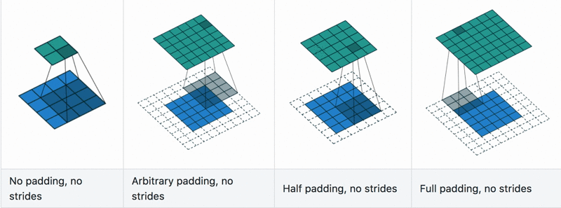
Convolution with padding in Action
https://github.com/vdumoulin/conv_arithmetic

Slide 65
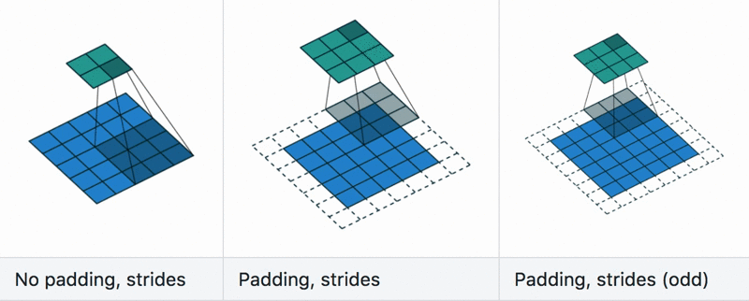
Convolution with stride in Action
https://github.com/vdumoulin/conv_arithmetic

Slide 66
Convolve in action

Slide 67
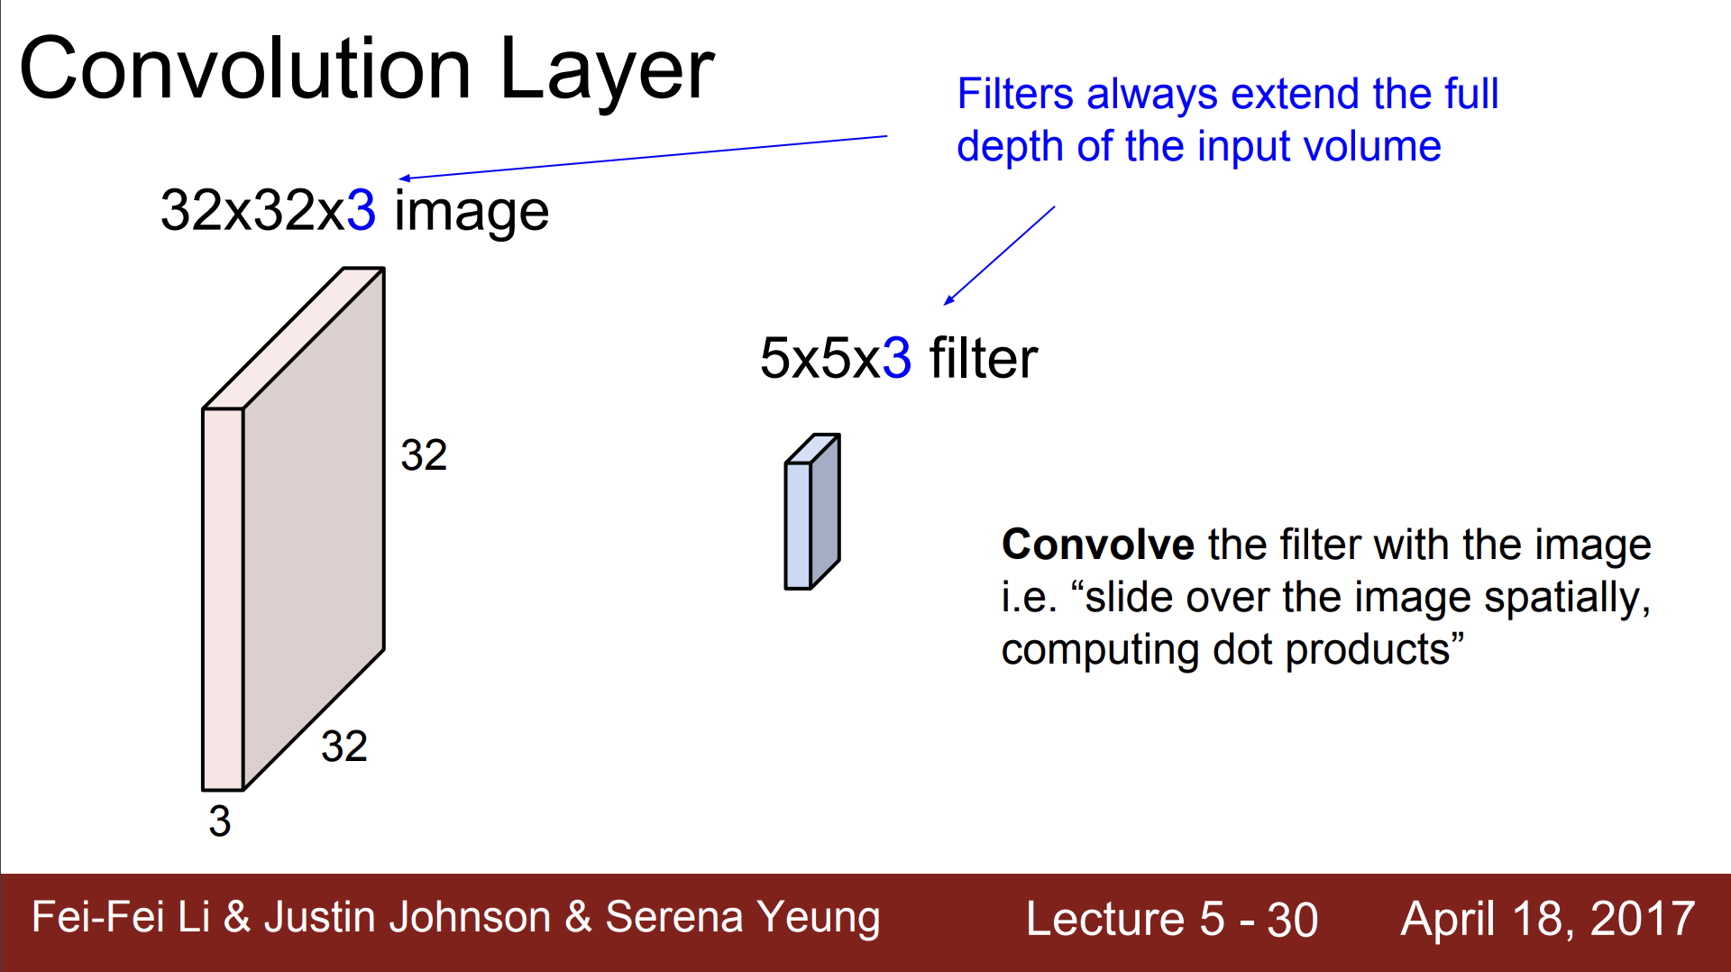

Slide 68
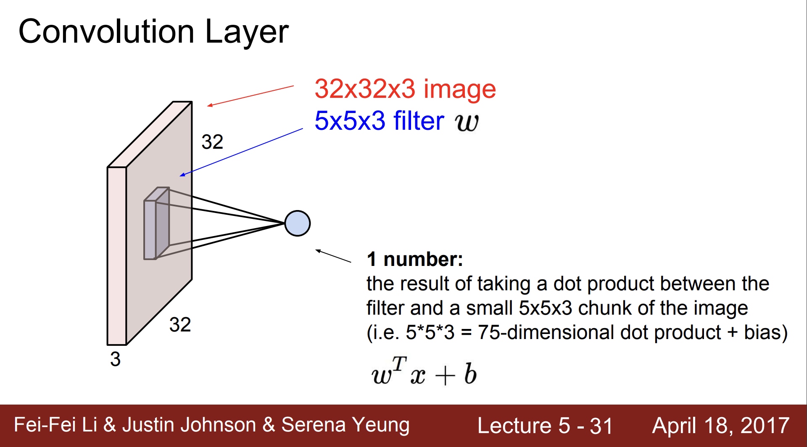

Slide 69
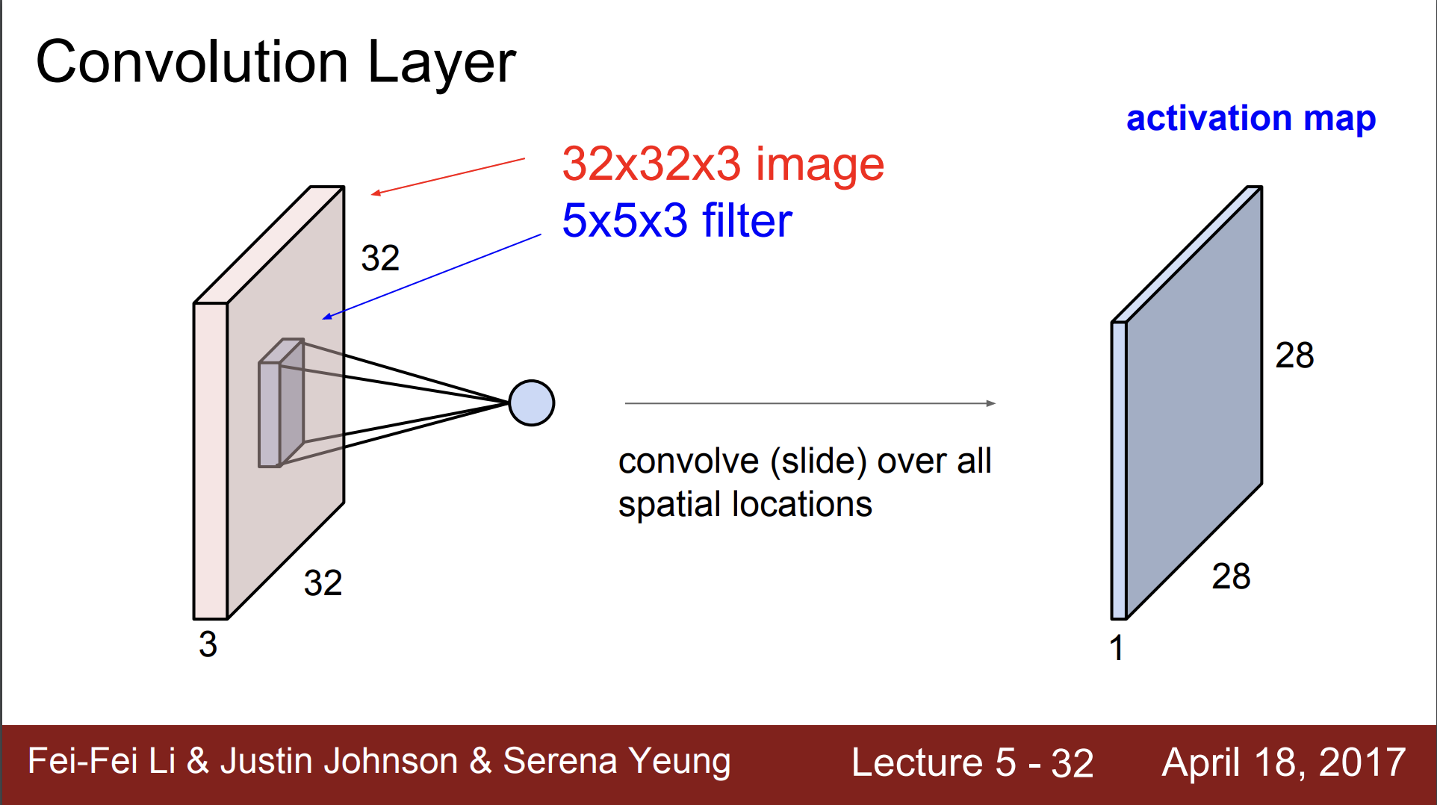

Slide 70
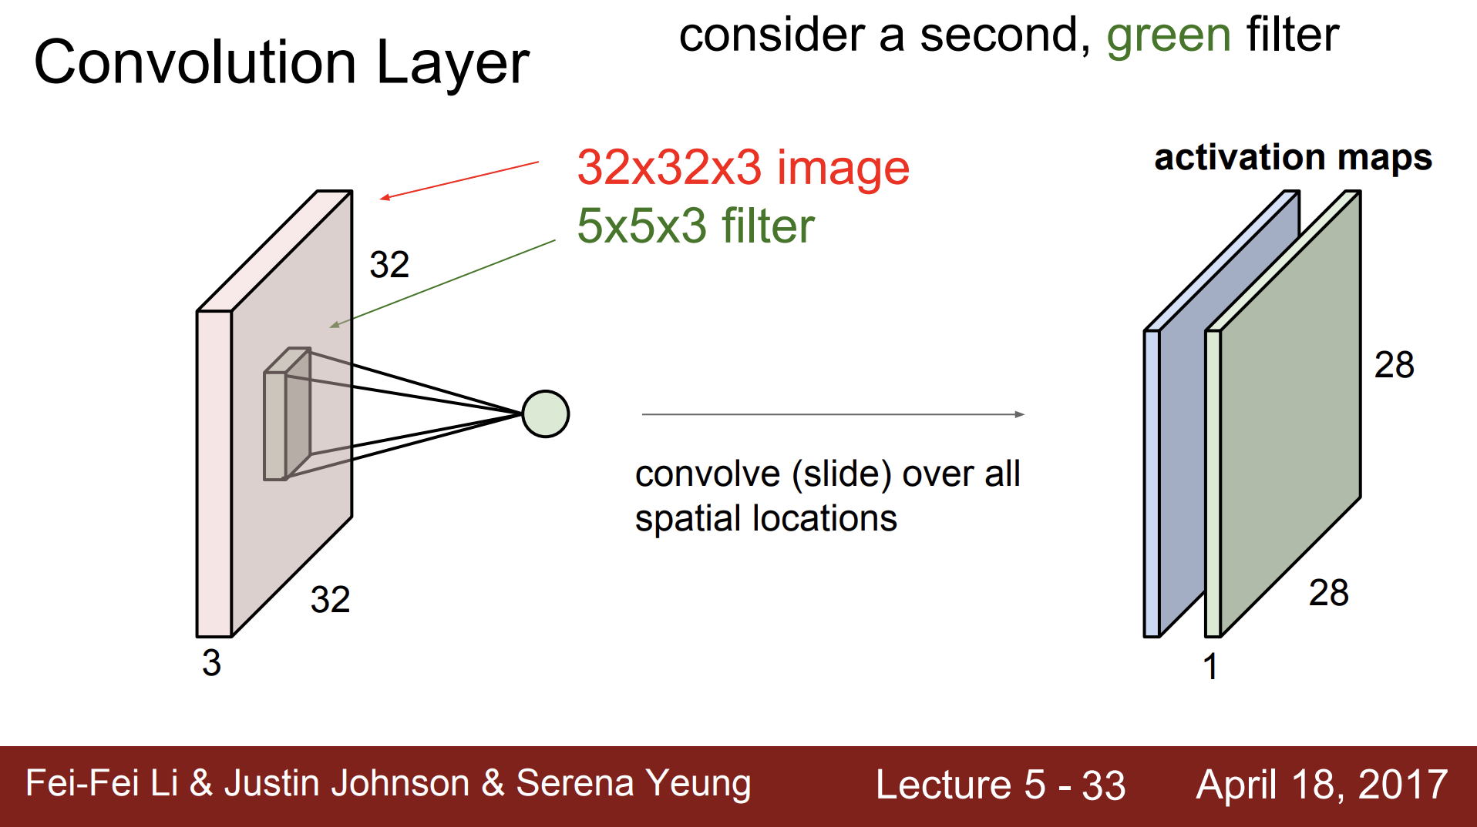

Slide 71
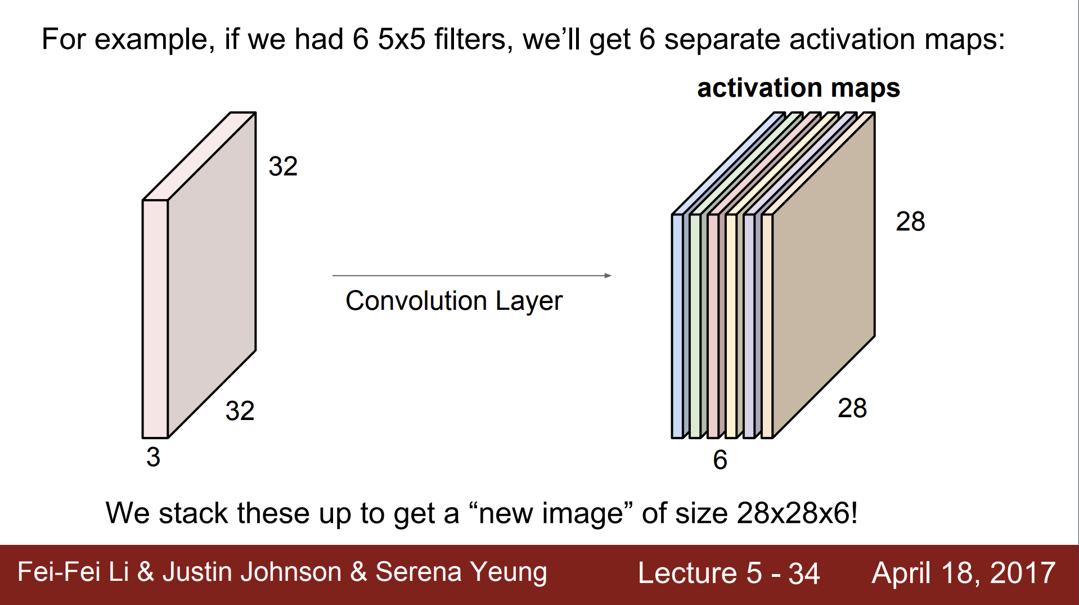

Slide 72
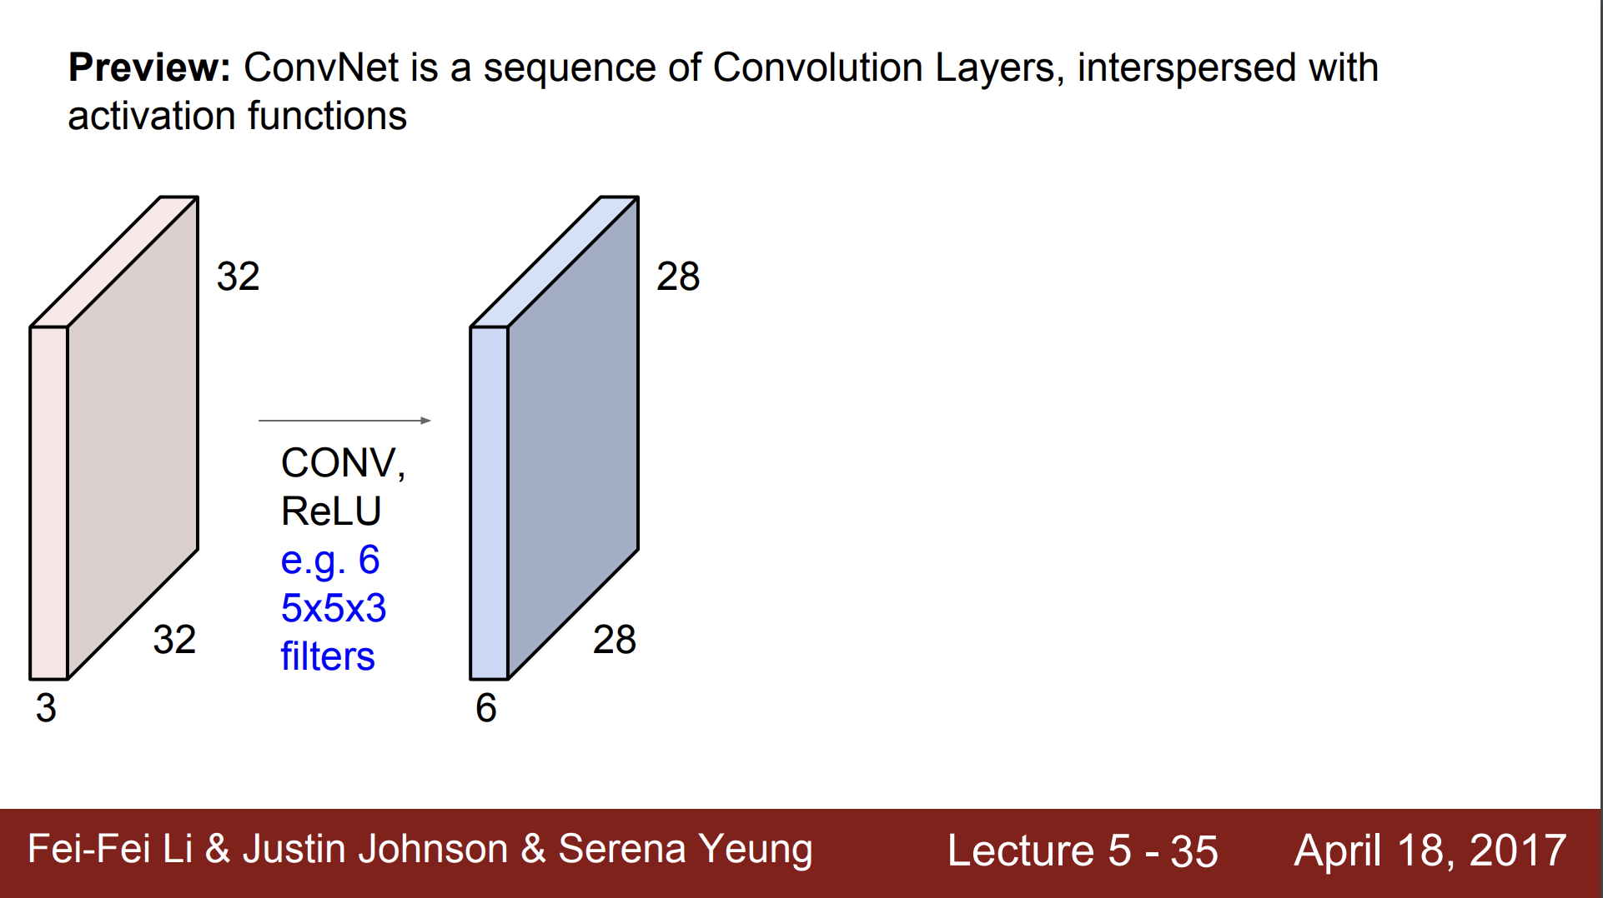

Slide 73
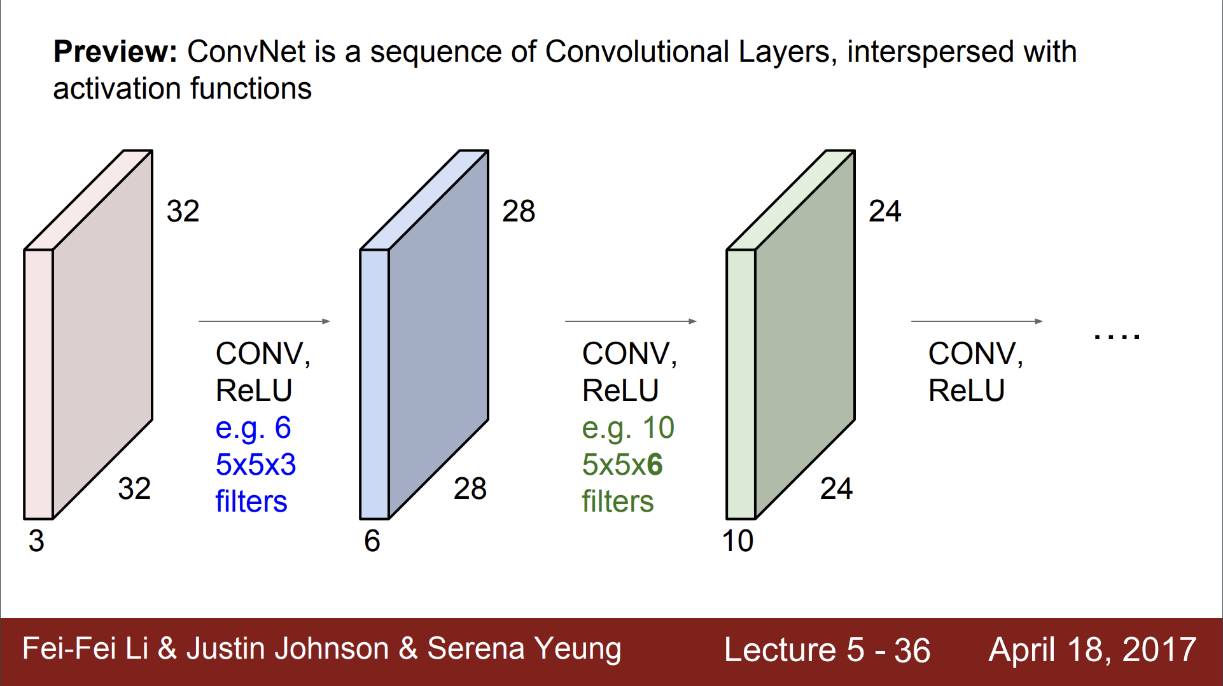

Slide 74
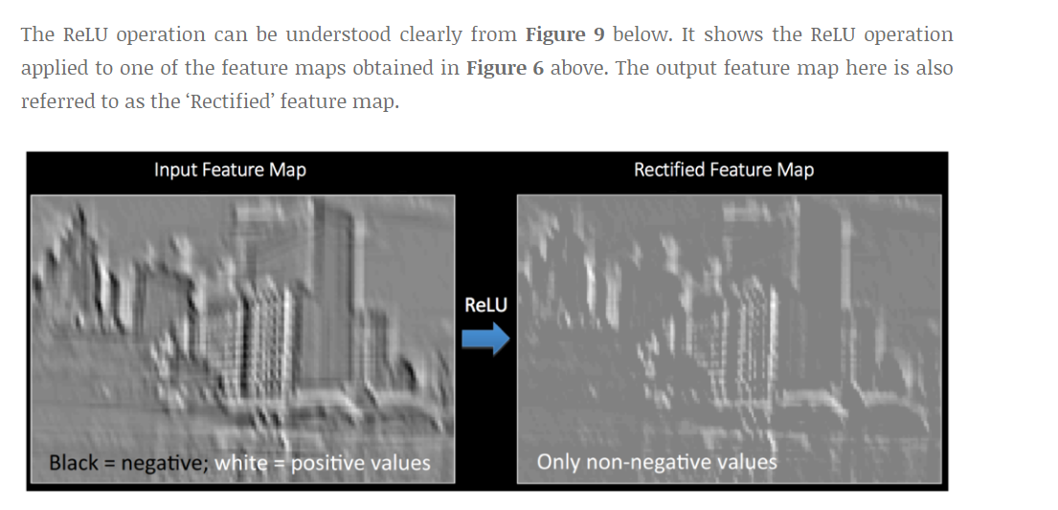
Relu

Slide 75
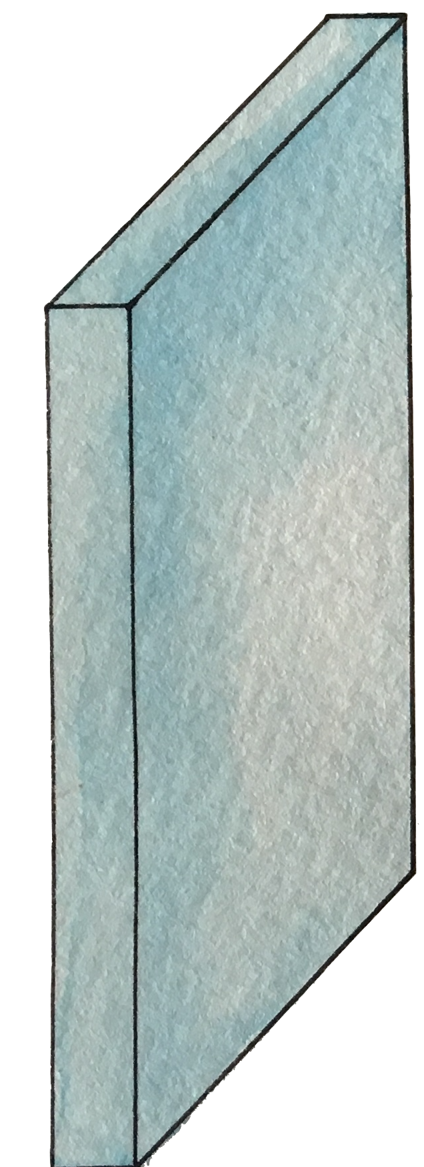


Max pooling

Slide 76
Pooling Layer

Slide 77

Max Pooling in Action
https://github.com/vdumoulin/conv_arithmetic

Slide 78

Avg Pooling in Action
https://github.com/vdumoulin/conv_arithmetic

Slide 79

Max Pooling in Action

Slide 80

Max Pooling in Action (with padding)

Slide 81

Max Pooling with depth of 3

Slide 82

Pooling

Slide 83
Reaons of pooling
Makes the input smaller and more manageable
Reduces the number of parameters and computations in the network,
Makes the network invariant to small transformations, distortions and translations in the input image
Small distortion in input will not change the output of Pooling – since we take the maximum / average value in a local neighborhood).
Helps us arrive at an almost scale invariant representation of our image
We can detect objects in an image no matter where they are located.

Slide 84

Fully Connected
https://github.com/vdumoulin/conv_arithmetic

Slide 85
Fully Connected
The Fully Connected layer is a traditional MLP that uses a softmax activation function in the output layer
The purpose of the Fully Connected layer is to use these features for classifying the input image into various classes based on the training dataset
The sum of FC layers’ probability is 1 ensured by Softmax to form a probability distribution.
https://github.com/vdumoulin/conv_arithmetic

Slide 86

實際運算，使用Im2col

Slide 87

CNN

Slide 88


Slide 89

Visualize the CNN

Slide 90


A hand-written digit ‘8’

Slide 91

A hand-written digit ‘8’

Slide 92

A hand-written digit ‘8’

Slide 93


A hand-written digit ‘8’

Slide 94


A hand-written digit ‘8’

Slide 95


Simple CNN

